Slide 1

How abundant are different kinds of photosynthesis proteins in wild Eucalyptus leaves? A continental-scale ecological proteomics project
Participants
Dr Lara Ainley
Ms Katy Breakwell
Ms Jennalee Clark
Dr Tory Clarke
Ms Michelle Demers
Dr Siobhan Dennison
Dr James Lawson
Dr Renée Marchin
Dr Steve Van Sluyter
Ms Leslie Ward
Prof Mark Westoby
Acknowledgements
Dr Mike Aspinwall, Profs Belinda Medlyn and David Tissue, Hawkesbury Institute for the Environment
Mr Chris Hodgkins, Sciex
Dr Adam Carroll, ANU
Dr Ben Crossett, University of Sydney
Funding
SIEF John Stocker Postdoctoral Fellowship
ARC Discovery Project

Slide 2
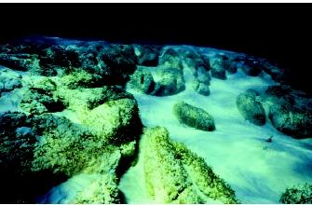
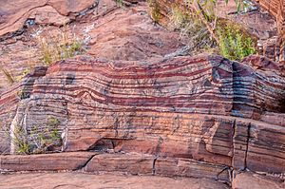
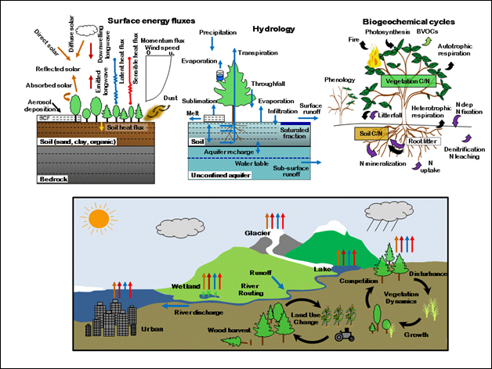
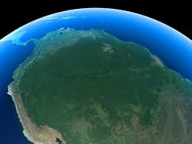
Banded ironstone formations, Dales Gorge, Pilbara WA
Lawrence et al. 2011 J. Adv. Model. Earth Sys

Slide 3
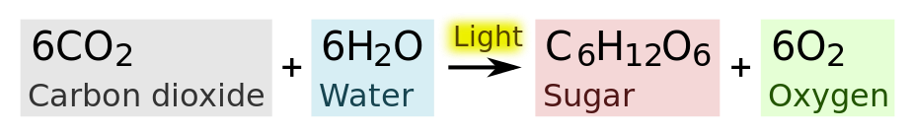
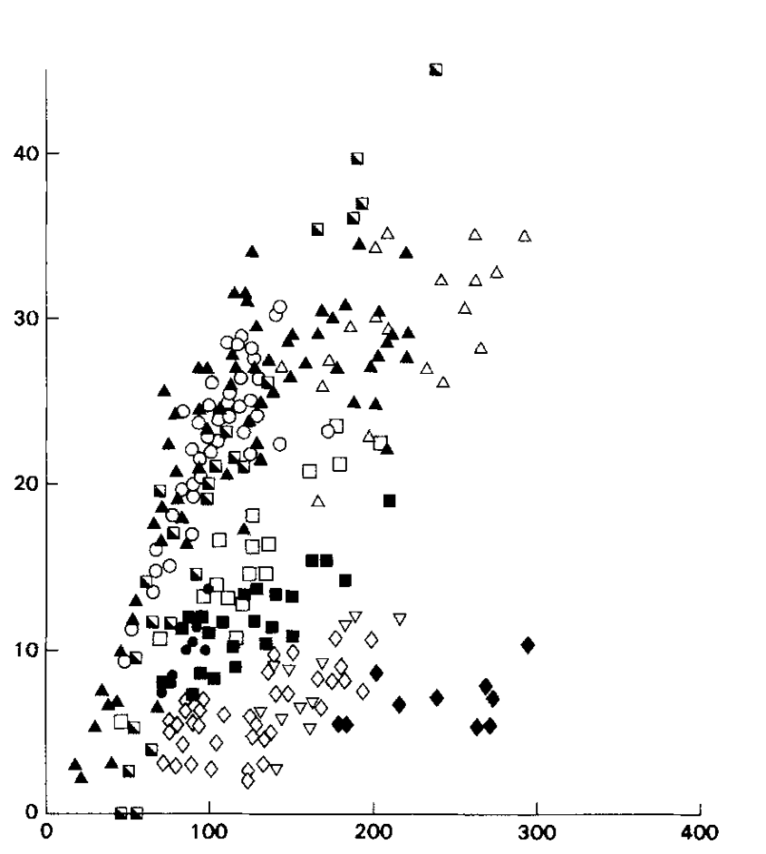
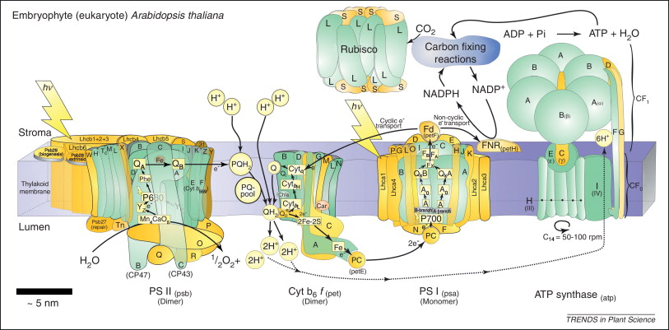
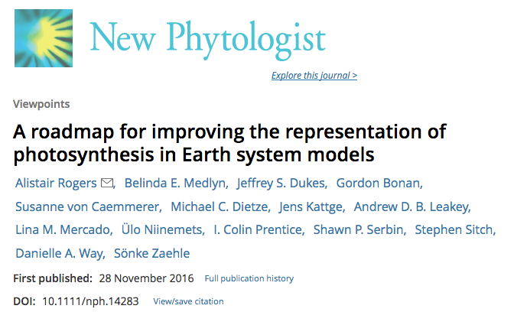
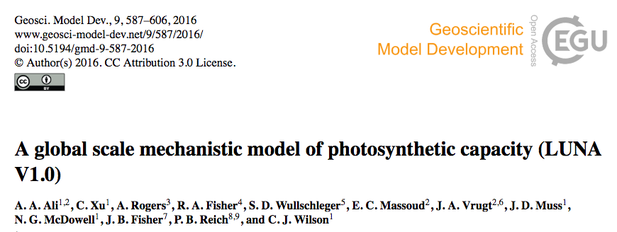
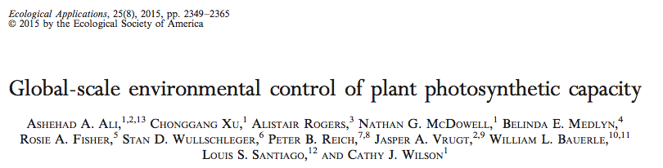
Photosynthetic capacity
Leaf N
Allen et al 2011 Trends Plant Sci
Evans 1989 Oecologia
Notes:
We have a pretty good understanding of the biochemistry of photosynthesis, but to estimate the actual capacity of wild plants to perform this reaction, we tend to rely on relatively simple, cheap methods such as measuring leaf nitrogen content. Leaf N content provides a reasonable estimate of photosynthetic capacity, since most N in a cell is in protein, and most protein in leaves is doing photosynthesis. But as you can see there’s a huge amount of scatter in this relationship.
Some recent terrestrial biosphere models have placed emphasis on modelling allocation of N resources to different functions within the photosynthetic apparatus, so as to better describe the relationship between leaf N and photosynthetic capacity. These models typically just estimate enzyme amounts. In the quantitative proteomics project I’m going to talk about we can put actual numbers on these enzyme amounts.
We haven’t gotten as far as incorporating our data into larger systems of models, and I won’t pretend to properly understand the nitty gritty of these papers. But I’d like to introduce our project to you and show the first set of results that have come out of it – that is, how abundant are different kinds of photosynthesis proteins in wild Eucalypt leaves. Extension of trait thinking.
Most N in a cell is protein. Proteins, not RNA, catalyze nearly all reactions in a cell. Changes in abundance of metabolic enzymes reflect changes in metabolism.
RNA is a much looser approximation of metabolic changes because protein amounts are dictated by translation rates and protein half-lives, both of which can’t be derived from RNA data.
N allocation strategies can be derived from proteomics because the most abundant proteins are identified.

Slide 4
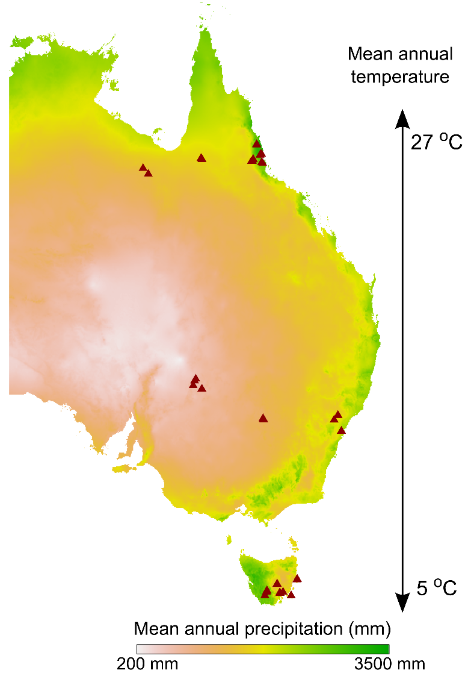
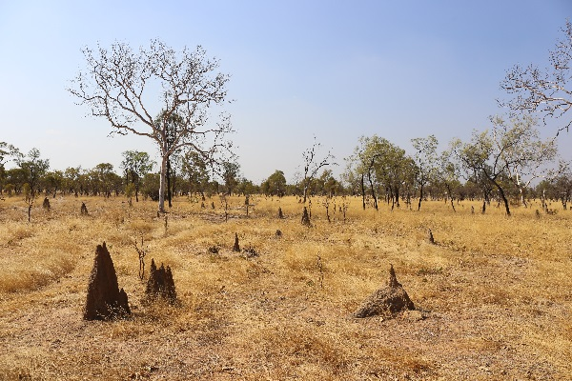
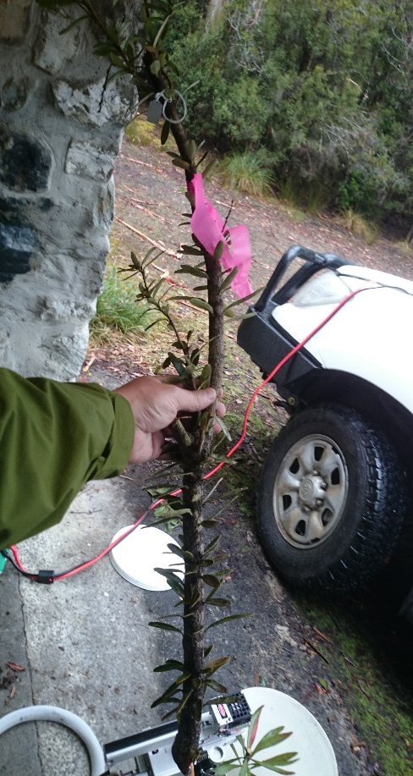
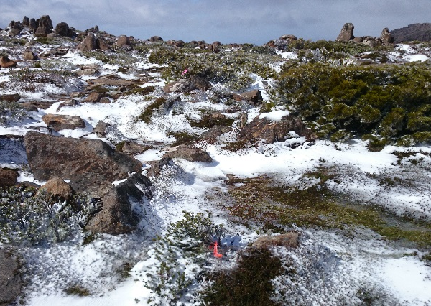
102 species: 32 eucalypts, 27 Acacia, 43 Proteaceae
>4000 samples; 1100 for proteomics
3 plants per species * site
3 leaf ages per plant + senescent leaves
Notes:
Emphasise continental scale. This is a really really massive study.

Slide 5
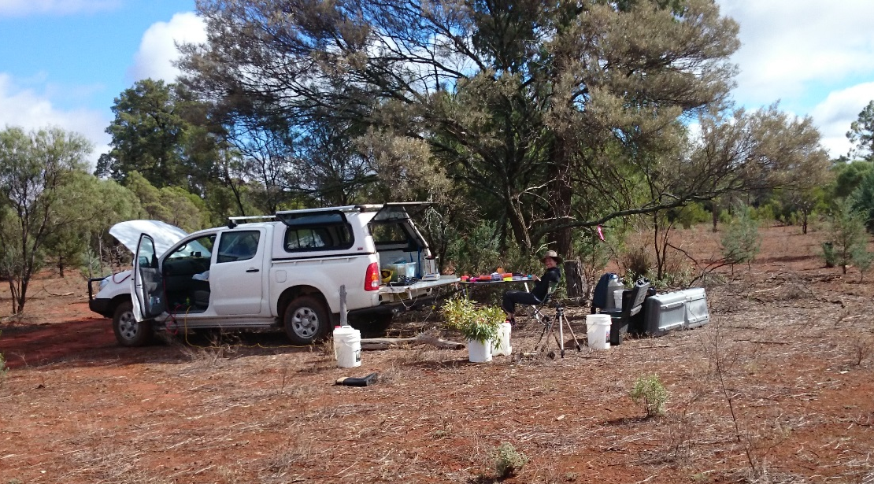
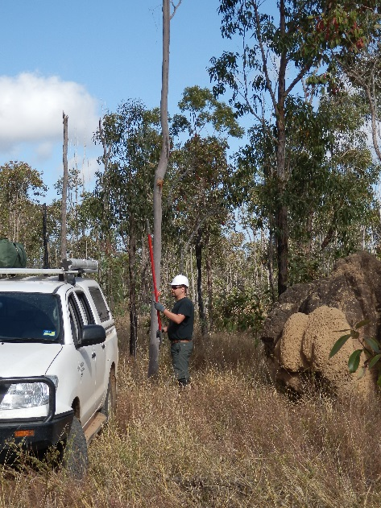
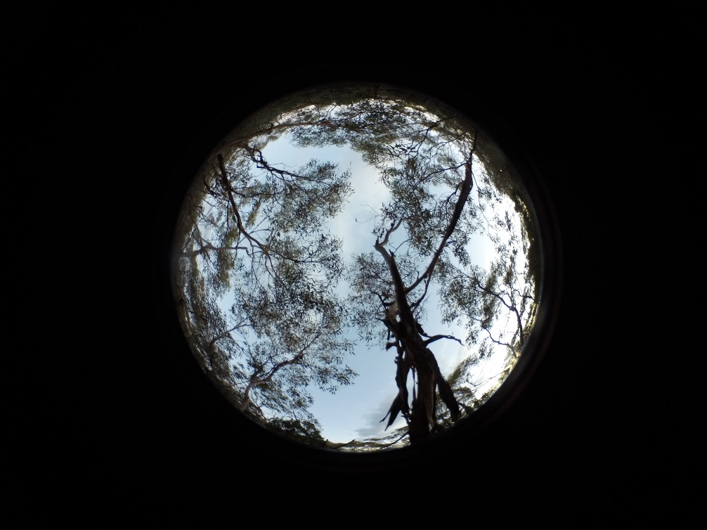
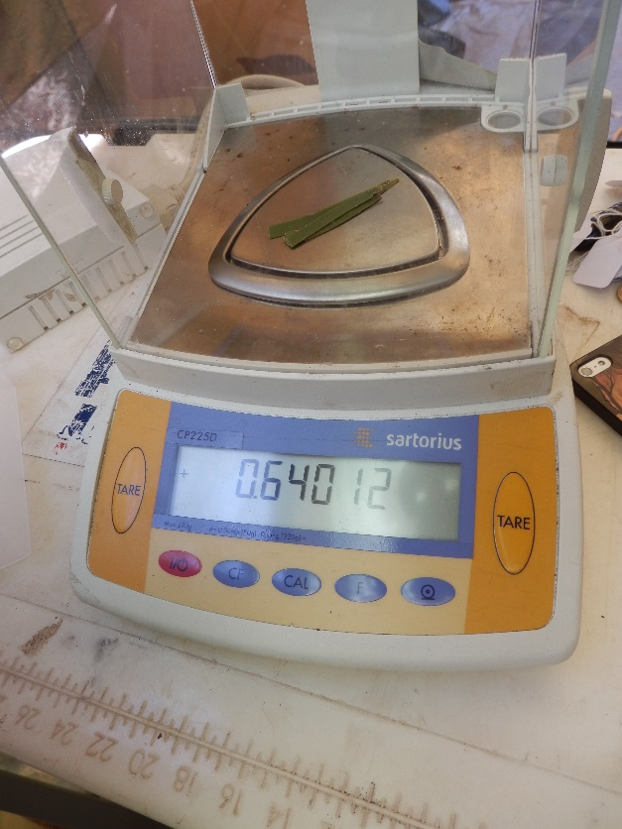
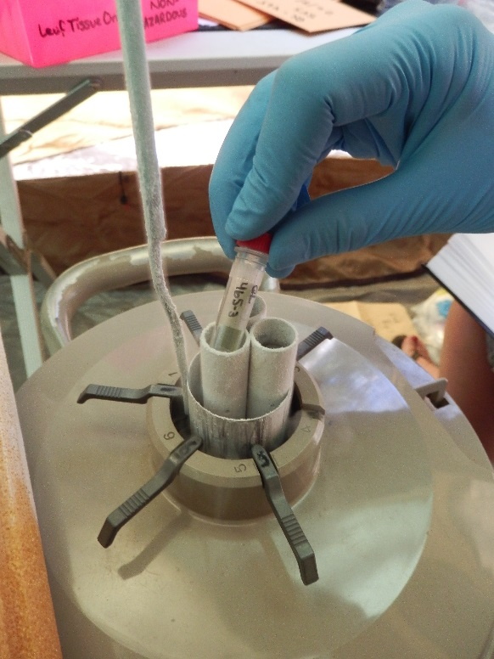
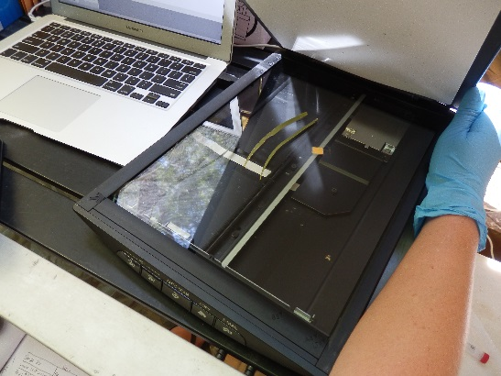
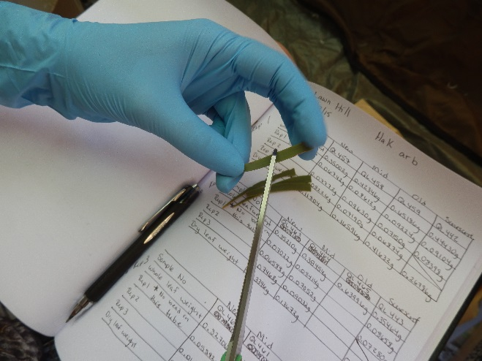

Slide 6
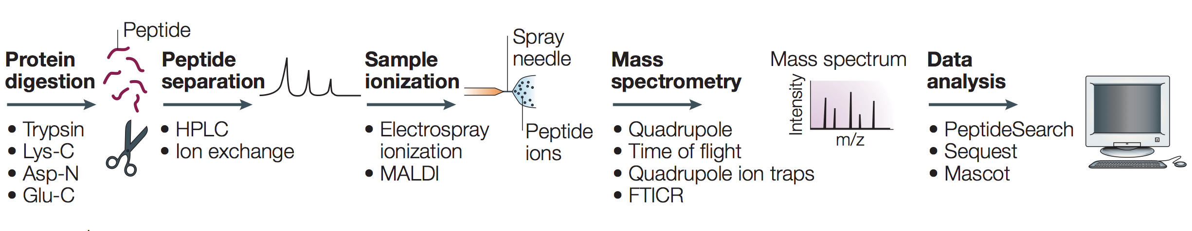
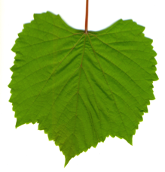
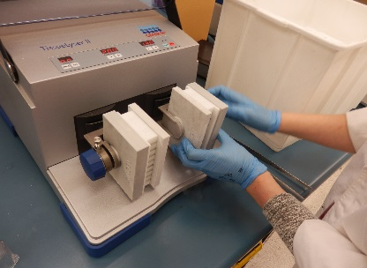
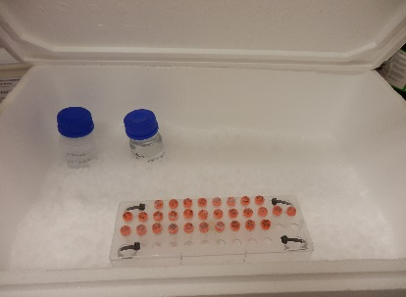
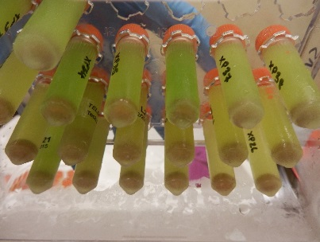
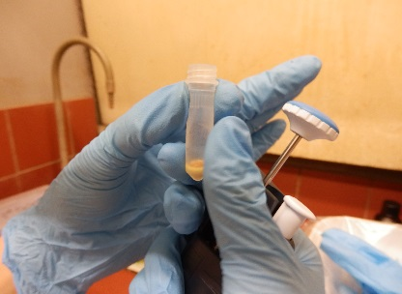
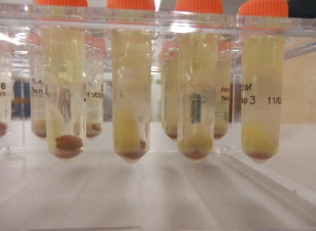
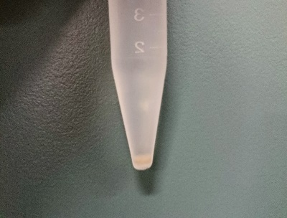
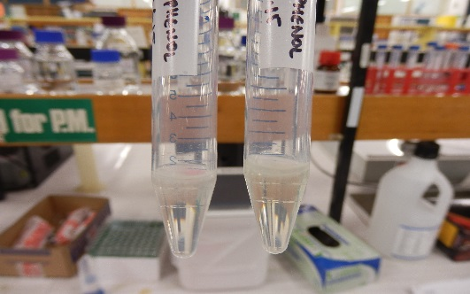
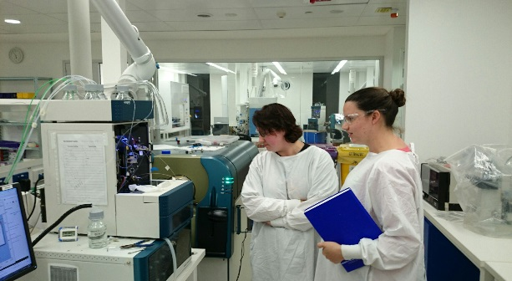
Protein extraction
120,000 MS/MS spectra collected
Liquid chromatography
Mass analyzers separate ions by mass/charge
MS/MS spectra assigned to proteins
Absolute protein quantification:
Quantitative protein extraction
Internal isotope labelled standards
mg/m² versus unitless relative comparisons
Cross species & cross experiment comparisons possible

Slide 7
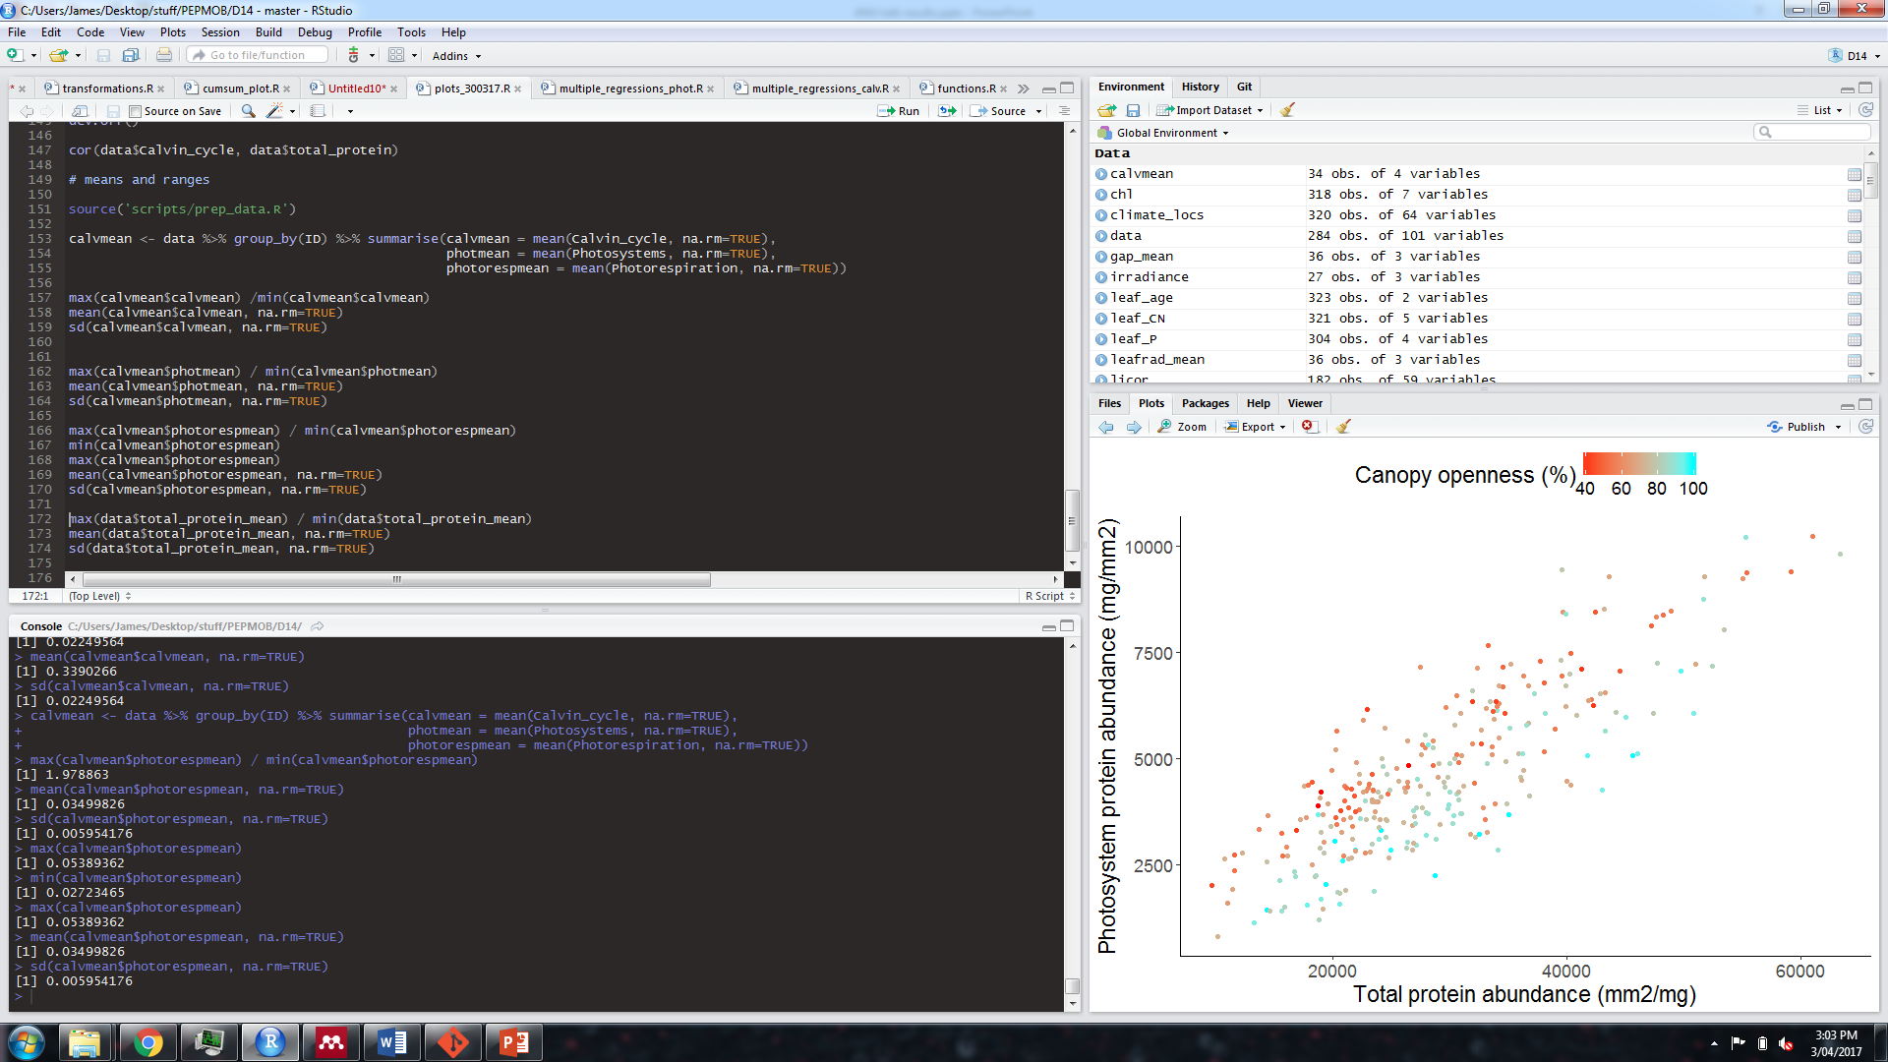
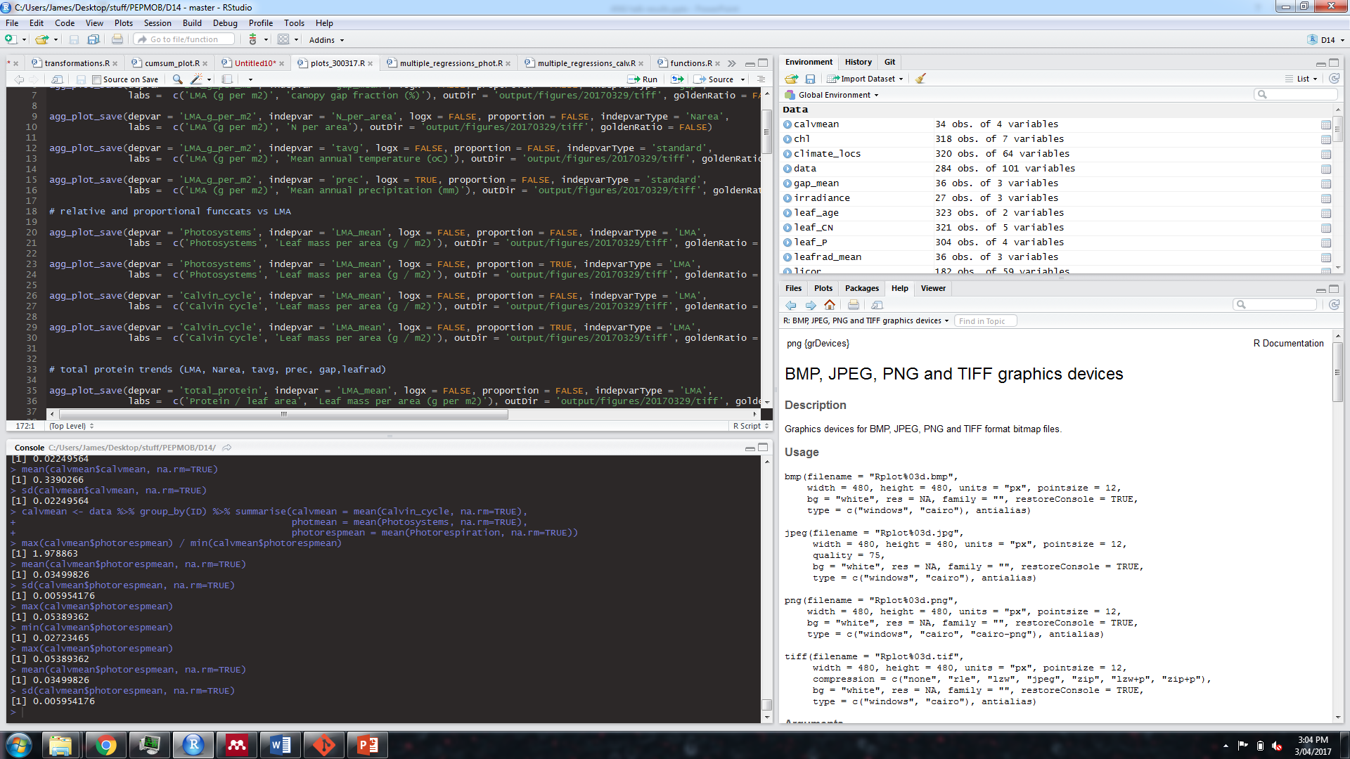
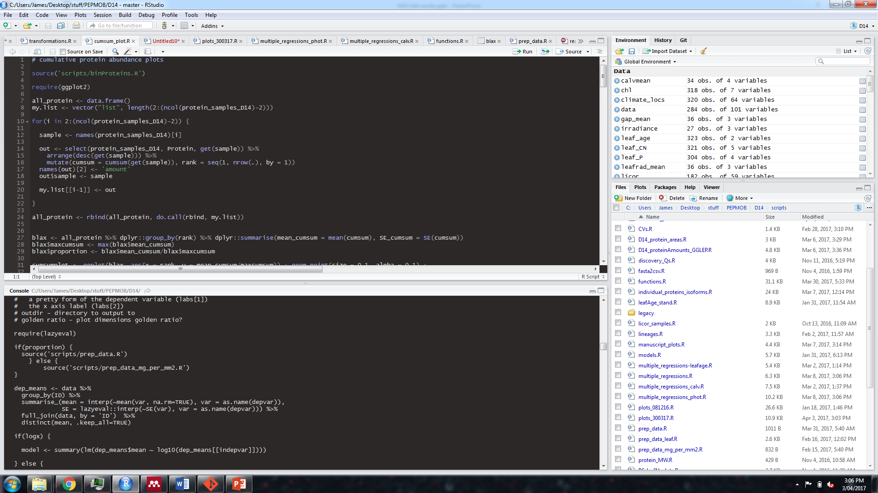
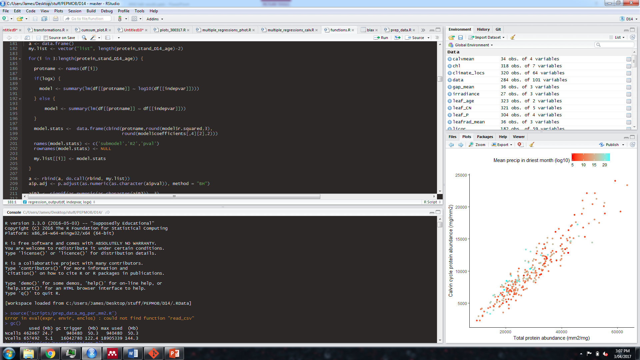

Slide 8
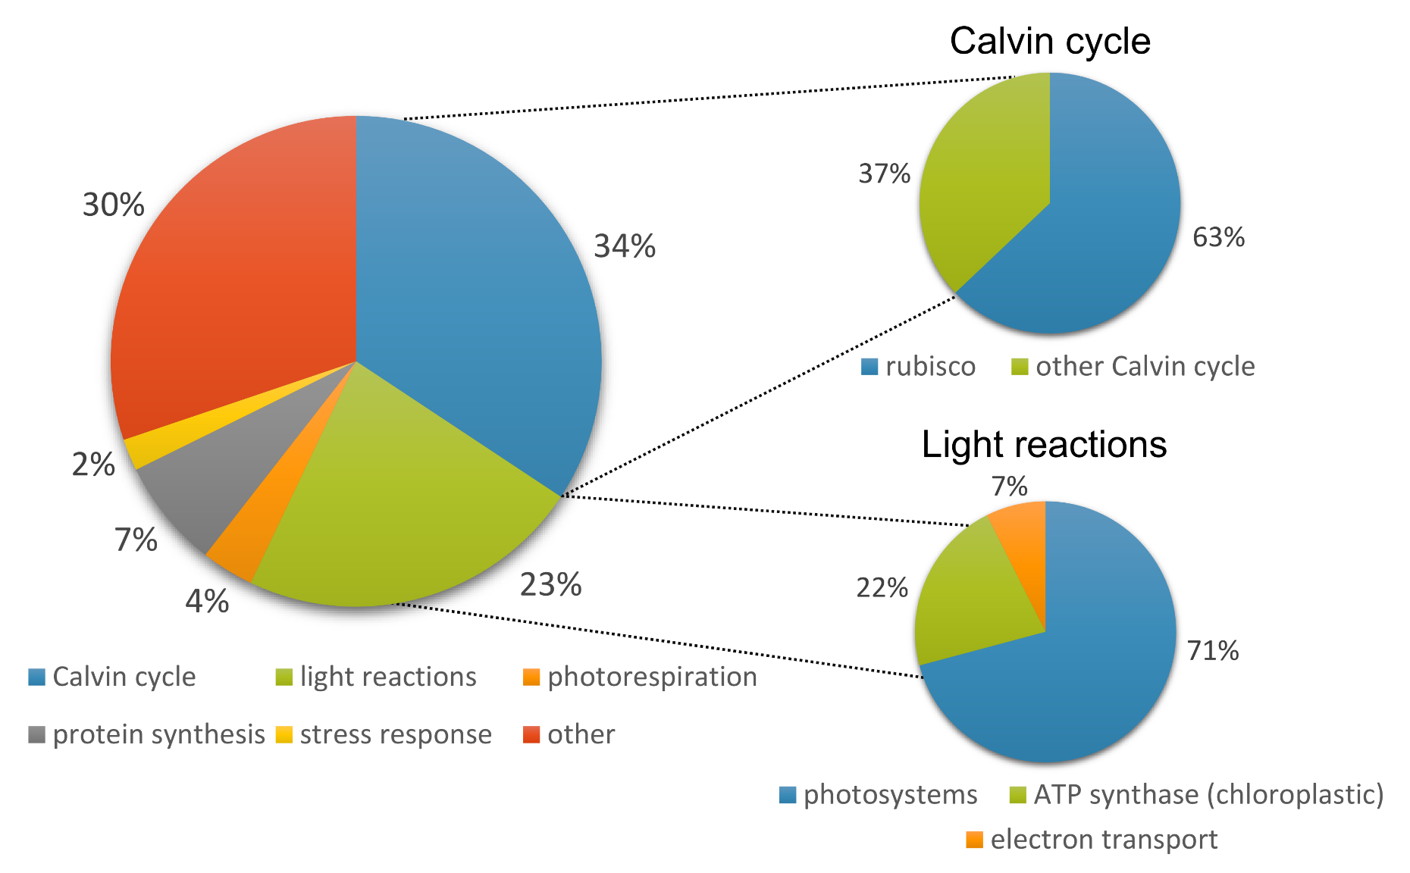
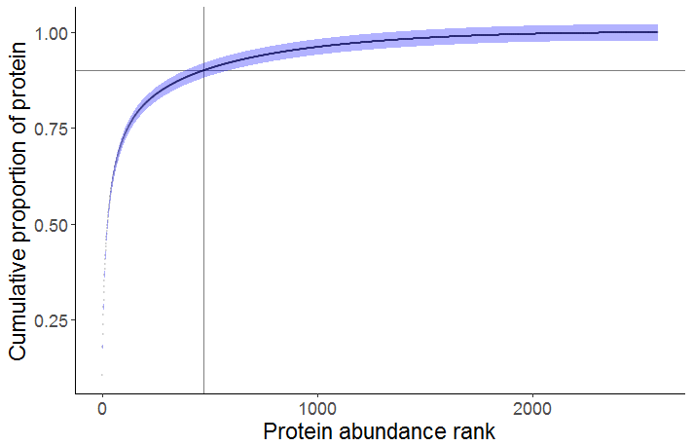
What’s in a leaf?
<500 proteins account for >90% total leaf protein
Leaf protein content ranges between 3 - 39 % of leaf dry mass (mean = 12 %, stdev = 4 %)
Notes:
Around 60% of the protein in our euc leaves was accounted for by photosynthesis proteins.
The mean abundances of the different functional categories shift around – as different samples have different proportions of protein within a given functional category at a given rank.
There are some gaps in the data here because of the cumulative summing code I used – it finds the average proportion of total protein for a given rank, and if there aren’t any proteins from that rank for a particular functional category then there’s a gap. Or just a point if there was just one sample with a protein at that rank.
The categories that have super abundant proteins – that would be Rubisco in the Calvin cycle and ATP synthase – start off being the most abundant but are gradually replaced as we increase the number of proteins.

Slide 9
Optimising the photosynthetic apparatus
Co-ordination hypothesis: leaves should optimise protein allocation so that photosynthesis is co-limited by light capture and carboxylation capacity
Protein allocation to photosystems should:
Decrease with increasing light
Protein allocation to Calvin cycle should:
Increase with increasing light
Decrease with increasing water availability

Slide 10
Allocation to photosystems is lower in high light
p < 0.001, R² = 0.43, 54 % decline
p < 0.001, R² = 0.37, 42 % decline
 | Min. | Max. | Mean | Std. dev. | Magnitude
Photosystems (proportion) | 0.09 | 0.23 | 0.16 | 0.03 | 2.5-fold
Notes:
Disentangling precip effect – if you look at precip over just the last year, there’s a much weaker correlation. Could mean that we’re really interested in time averaged effect on vegetation structure and light evnrio

Slide 11

Allocation to photosystems is lower in high light
p < 0.001, R² = 0.43, 54 % decline
p < 0.001, R² = 0.37, 42 % decline
 | Min. | Max. | Mean | Std. dev. | Magnitude
Photosystems (proportion) | 0.09 | 0.23 | 0.16 | 0.03 | 2.5-fold
Notes:
Disentangling precip effect – if you look at precip over just the last year, there’s a much weaker correlation. Could mean that we’re really interested in time averaged effect on vegetation structure and light evnrio

Slide 12
Environmental trends in abundance of Calvin cycle proteins
p = 0.19
p =0.02, R² = 0.16, 8 % increase
p = 0.07
 | Min. | Max. | Mean | Std. dev. | Magnitude
Calvin cycle (proportion) | 0.29 | 0.38 | 0.339 | 0.023 | 1.3-fold

Slide 13
Environmental trends in abundance of Calvin cycle proteins
p = 0.19
p =0.02, R² = 0.16, 8 % increase
p = 0.07
 | Min. | Max. | Mean | Std. dev. | Magnitude
Calvin cycle (proportion) | 0.29 | 0.38 | 0.339 | 0.023 | 1.3-fold

Slide 14
Room to move? Variation in proportional allocation
r = 0.82
r = 0.95
 | Min. | Max. | Mean | Std. dev. | Magnitude
Photosystems (proportion) | 0.09 | 0.23 | 0.16 | 0.03 | 2.5-fold
Calvin cycle (proportion) | 0.29 | 0.38 | 0.339 | 0.023 | 1.3-fold
Notes:
Photosystem abundance tracks total protein abundance less tightly than Calvin cycle abundance does. Leaves have more scope to alter proportional investment in photosystem proteins than Calvin cycle proteins.
Optimisation of carboxylation capacity more likely to be achieved by altering total leaf protein. One way to do this is by changing leaf mass per area

Slide 15
Influence of leaf anatomy on protein abundance
p = 0.88
p < 0.001, R² = 0.26
p < 0.001, R² = 0.31
p = 0.01, R² = 0.20
p = 0.15
Notes:
Leaves don’t produce more photosystem proteins as they become thicker, but they do produce more Calvin cycle proteins (and pretty much every other category of protein). Suggests that carboxylation capacity is added by leaf thickening but there is no effect on light capture.

Slide 16
Environmental trends in leaf mass per area
p = 0.01, R² = 0.19
p < 0.001, R² = 0.21

Slide 17
Environmental trends in leaf mass per area
p = 0.01, R² = 0.19
p < 0.001, R² = 0.21

Slide 18
Summary
The bulk of leaf protein is associated with photosynthesis
Leaves adjust proportional protein allocation to photosystem proteins in response to light availability
Environmental factors have only a marginal influence on proportional abundance of Calvin cycle proteins
Optimisation of carboxylation capacity is likely achieved by altering leaf anatomy and the total amount of protein per leaf area

Slide 19
Where to next?
Comparative work using data from Acacia and the Proteaceae
Responses of other protein functional groups across environmental gradients
Parameterising systems-level models of photosynthesis and terrestrial biosphere models

Slide 20
Participants
Dr Lara Ainley
Ms Katy Breakwell
Ms Jennalee Clark
Dr Tory Clarke
Ms Michelle Demers
Dr Siobhan Dennison
Dr James Lawson
Dr Renée Marchin
Dr Steve Van Sluyter
Ms Leslie Ward
Prof Mark Westoby
Acknowledgements
Dr Mike Aspinwall, Profs Belinda Medlyn and David Tissue, Hawkesbury Institute for the Environment
Mr Chris Hodgkins, Sciex
Dr Adam Carroll, ANU
Dr Ben Crossett, University of Sydney
Funding
SIEF John Stocker Postdoctoral Fellowship
ARC Discovery Project

